Slide 1
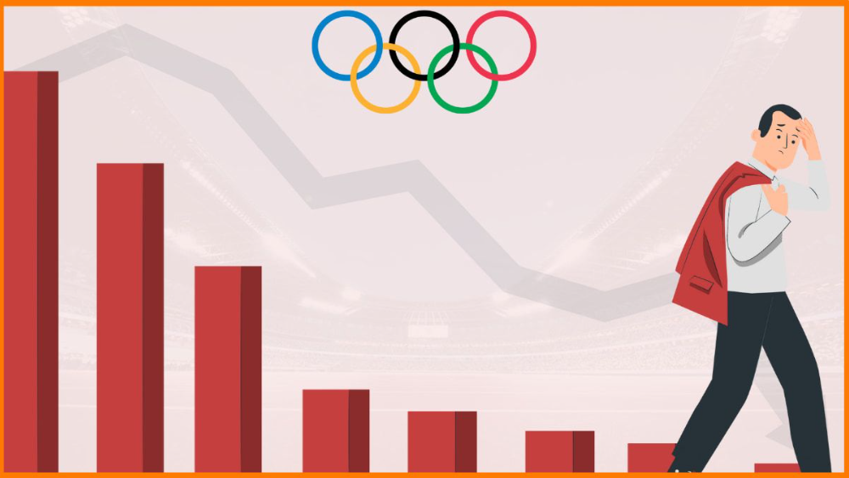
SPORTS ANALYSIS
MECE BREAKDOWN

Slide 2


Game Analysis
Historical overview of the Olympics
Trends in the number of participating countries.
Sports and events Analysis
Distribution of sports in Summer and winter Olympics.
Participants Analysis
Comparison of Summer and Winter Olympics
Frequency of the Games over the years.
Multi-City hosting Analysis
Most popular sports and events.
Evolution sports and events.
Demographic of participants (age, gender, height ,weight).
Trends in participant numbers over the years.
Representation of countries in terms of participants.

Slide 3

Medals Analysis
Medals distribution by country.
Regional Representation Analysis
Regional distribution of participating countries.
Performance trends of countries over different editions.
Dominant regions in terms of medals and participants.
Trends in regional participation overt time .
Correlation between country’s population.

Slide 4
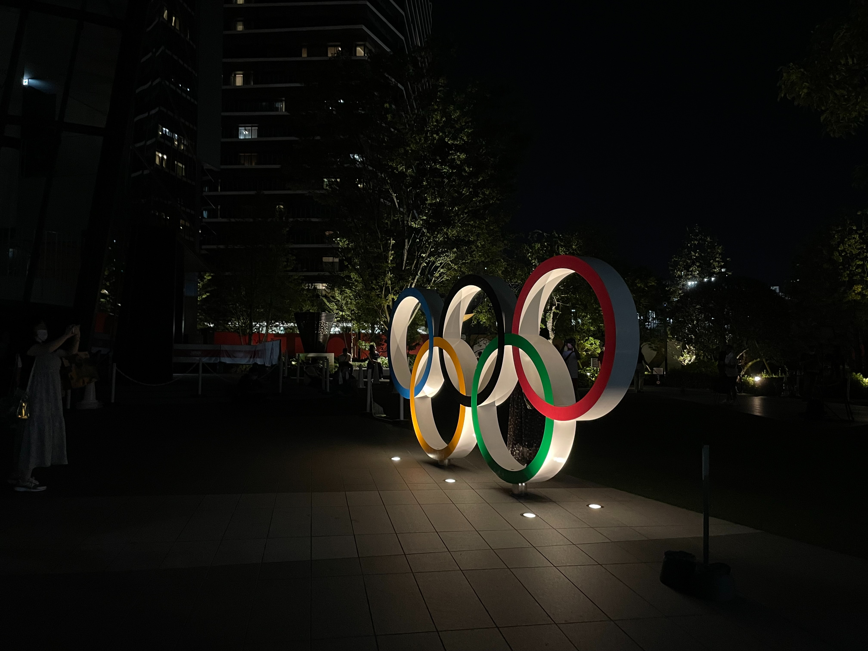
By analysing these dimensions of the Olympic Games data, I aim to provide a comprehensive overview of its history and evolution, identifying trends, patterns and significant insights. These insights can serve as a foundation for recommendations to enhance the organizations sports selection and regional representation of future Olympic Games. The final deliverable will encapsulate these findings and their historical significance aiding in informed decision-making for the betterment prestigious Olympics Games.
THANK YOU!

